Slide 1
Traumatic Brain Injuries in North Carolina, 2023
Division of Public Health
Data updated March 7, 2025
Notes:
This slide set was created to provide basic data trends and public health surveillance around mortality and morbidity of traumatic brain injuries (TBI). They are meant to offer a state-level background on TBI. If you’d like a copy of the slides, please visit the “Traumatic Brain Injury” Data page on our branch website, https://www.dph.ncdhhs.gov/programs/chronic-disease-and-injury/injury-and-violence-prevention-branch. The direct link is also shared at the end of this presentation.
Feel free to incorporate these slides into your own presentations, grant proposals, reports, or any other way they may be useful.
Please read both the speaking and technical notes to ensure that data are presented in a consistent manner.

Slide 2
Traumatic Brain Injury Technical Notes
Surveillance methods have been updated to identify any mention of an injury in our morbidity data sources. Individual records with multiple injuries listed will be included in the total for each of those injuries but only counted once for overall total injury count. Previously, only the first listed injury was counted, which has resulted in an increase in the number of specific injuries identified.
For questions or for more information see technical notes document available at https://injuryfreenc.dph.ncdhhs.gov/DataSurveillance/
Case definitions used:
Deaths – ICD-10 codes listed as cause of death: S01.0-S01.9, S02.2, S02.1, S02.3, S02.7-S02.9, S04.0, S06.0-S06.9, S07.0, S07.1, S07.8, S07.9, S09.7-S09.9, T01.0, T02.0, T04.0, T06.0, T90.2, T90.4, T90.5, T90.8, T90.9
*See technical notes document for a full list of ICD-10 codes used for TBI deaths
Notes:
For more detailed technical notes on any of the data shared in this slide set, please contact us at InjuryData@dhhs.nc.gov.

Slide 3
Technical Notes, Continued
Hospitalizations – Among records with an ICD-10-CM injury code,* any mention of the following ICD-10-CM codes (includes records resulting in death)
Emergency Department Visits – Any mention of the following ICD-10-CM codes (includes records resulting in hospitalization or death)
S02.0, S02.1 | Fracture of skull
S02.8, S02.91 | Fracture of other specified skull and facial bones; unspecified fracture
S04.02, S04.03, S04.04 | Injury of optic chiasm; injury of optic tract and pathways; injuries of visual cortex
S06 | Intracranial injury
S07.1 | Crushing injury of skull
T74.4 | Shaken infant syndrome
*7th character of A, B, or missing (reflects initial encounter, active treatment)
*See technical notes document for a full list of ICD-10-CM injury diagnosis codes
Notes:
For more detailed technical notes on any of the data shared in this slide set, please contact us at InjuryData@dhhs.nc.gov.

Slide 4
Most older adults (ages 65+) in NC are non-Hispanic White
NH = non-Hispanic
Source: US Census non-bridged population estimates, 2023; ages 65 and older
Notes:
In 2023, most North Carolinians ages 65 and older are non-Hispanic White (76%). The second largest racial/ethnic group among North Carolinians ages 65 and older are non-Hispanic Blacks (17%).

Slide 5
Demographic characteristics among older adults in North Carolina
43%
of housing units with people 65 and older are single person households
* Adults ages 65 and older
Source: American Community Survey, 2023 5-year estimates. Table S0103: Population 65 and older
Notes:
According to the 2023 American Community Survey, 43% of housing units with people 65 and older are single person households. 1/3 (33%) of North Carolina adults ages 65 and older have a disability. 30% of North Carolina adults ages 65 and older have a high school education/G.E.D.

Slide 6
One in five older adults in NC reports
trouble walking
Disability among adults 65 and older
Source: American Community Survey, 2023 5-year estimates. Table S1810: Population 65 and older
Notes:
According to the 2023 American Community Survey, approximately 1 in 5 North Carolina adults ages 65 and over reported having trouble walking. Furthermore, North Carolina adults ages 65 and over experience hearing (14%), cognitive (8%), vision (6%), and self-care disabilities (7%). About 13% of people ages 65 and older in North Carolina also reported living alone/independently.

Slide 7
Around 74% of older adults in NC have
one or more chronic diseases
Source: NC State Center of Health Statistics, 2023 Behavioral Risk Factor Surveillance System (BRFSS) Survey Results
Notes:
In North Carolina, approximately 74% of adults ages 65 and older have one or more chronic disease. Among adults ages 65-74, 38% have 2 or more chronic diseases. About 47% of North Carolina adults ages 75 and older have 2 or more chronic diseases.

Slide 8
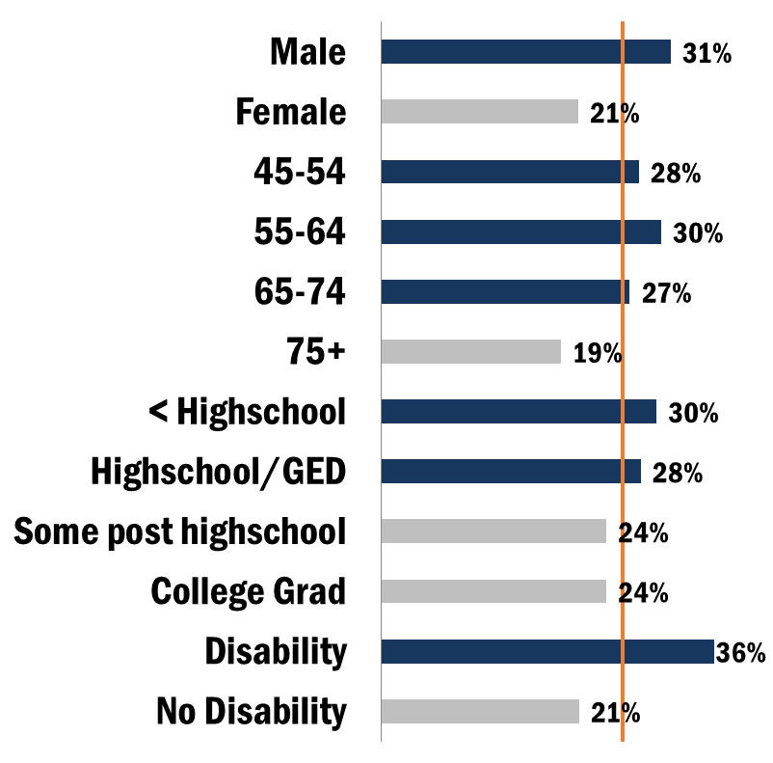
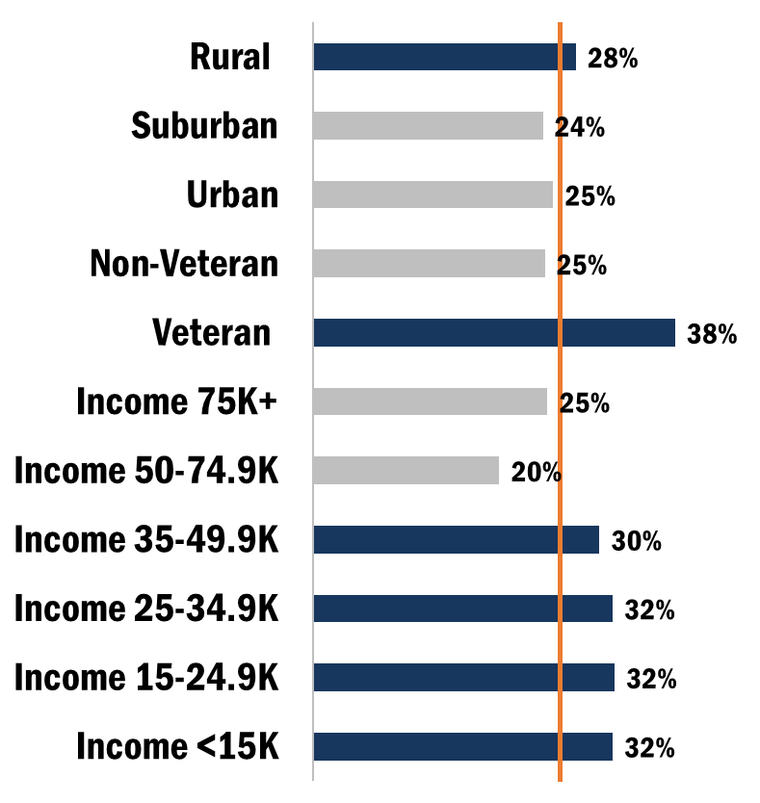
Proportion of demographic groups reporting having ever experienced loss of consciousness, 2019 BRFSS
Overall 26%
Overall 26%
Source: NC State Center of Health Statistics, 2019 Behavioral Risk Factor Surveillance System (BRFSS) Survey Results
Notes:
According to the 2019 Behavior Risk Factor Surveillance System (BRFSS) Survey, 26% of North Carolina respondents reported experiencing loss of consciousness. Individuals with a disability (36%), veterans (38%), males (31%), and individuals ages 55-64 (30%) had the highest proportions of reporting loss of consciousness.

Slide 9
TBI deaths are the tip of the iceberg
Despite NC’s excellent reporting systems, the total burden of TBI in the state
is unknown.
2,581
Deaths
7,665
Hospitalizations
34,585
ED Visits
? Outpatient Visits
? Medically Unattended Injuries
INJURY ICEBERG
Limited to NC Residents, 2023
Source: NC State Center for Health Statistics, Vital Statistics – Deaths (2023) and Hospitalization Discharge Data (2023); NC DETECT (2023)
Analysis by Injury Epidemiology and Surveillance Unit
Notes:
In 2023 there were 2,581 deaths, 7,665 hospitalizations, and 34,585 emergency department visits associated with unintentional TBI injuries in North Carolina. However, this is just the tip of the iceberg and the total burden of TBI injury in North Carolina is unknown.

Slide 10

Traumatic Brain Injury Deaths

Slide 11
TBI-related deaths increased by 36% over the last five years
Limited to NC Residents, 2014-2023
Source: NC State Center for Health Statistics, Vital Statistics – Deaths (2014-2023)
Analysis by Injury Epidemiology and Surveillance Unit
Notes:
The number of TBI deaths in North Carolina has increased by 36% over the last 10 years (2014-2023).

Slide 12
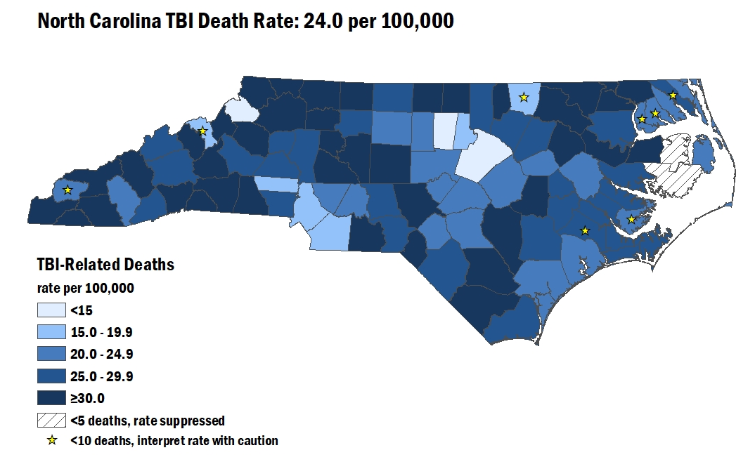
TBI-Related Deaths among North Carolina Residents, 2021-2023
Limited to NC Residents, 2021-2023
Source: NC State Center for Health Statistics, Vital Statistics – Deaths (2021-2023)
Analysis by Injury Epidemiology and Surveillance Unit
Notes:
The overall rate of TBI deaths from 2021-2023 in North Carolina was 24.5 per 100,000. The counties with the highest rates were Gates, Polk, and Cherokee counties.

Slide 13
Rates of TBI-related deaths were highest among men and non-Hispanic American Indian / Alaska Natives
Rate by Demographic, 2023
Limited to NC Residents, 2023, N=2,581
Source: NC State Center for Health Statistics, Vital Statistics – Deaths (2023)
Analysis by Injury Epidemiology and Surveillance Unit
Notes:
In 2023, the groups with the highest rate of TBI-deaths occurred amongst male North Carolina residents (35.4 per 100,000) and non-Hispanic American Indians (30.5 per 100,000).

Slide 14
Self-Inflicted Firearm was the leading mechanism-intent category for all TBI deaths
52.8% Unintentional
35.1% Self-Inflicted
11% Assault
* Included in other specified are Other Transport - Unintentional (0%), Struck By/Against - Assault (0%),
and Unspecified - Unintentional (2%), as well as other mechanism/intents.
Notes:
Self-inflicted firearm (34.9%) was the leading mechanism-intent category for TBI deaths. 52.8% of intents were unintentional, followed by self-inflicted (35.1%) and assault (11%).

Slide 15
Fall-Related TBI Deaths were most common among men and non-Hispanic Whites
Count of Deaths Demographic, 2023
Limited to NC Residents, 2023, N=2,581
Source: NC State Center for Health Statistics, Vital Statistics – Deaths (2023)
Analysis by Injury Epidemiology and Surveillance Unit
Notes:
The highest number of fall-related TBI deaths occurred in males and non-Hispanic White individuals.

Slide 16
Fall-related TBI death rates were highest among men and non-Hispanic Whites
Rate by Demographic, 2023
Limited to NC Residents, 2023, N=2,581
Source: NC State Center for Health Statistics, Vital Statistics – Deaths (2023)
Analysis by Injury Epidemiology and Surveillance Unit
Notes:
The highest rate of fall-related TBI deaths also occurred in males and non-Hispanic Whites.

Slide 17

Traumatic Brain Injury Hospitalizations

Slide 18
TBI-related hospitalizations increased by 6% over the last five years
Limited to NC Residents, 2019-2023
Source: NC State Center for Health Statistics, Hospitalization Discharge Data (2019-2023)
Analysis by Injury Epidemiology and Surveillance Unit
Notes:
The number of TBI hospitalizations in North Carolina increased by 6% over the last 5 years (2019-2023).

Slide 19
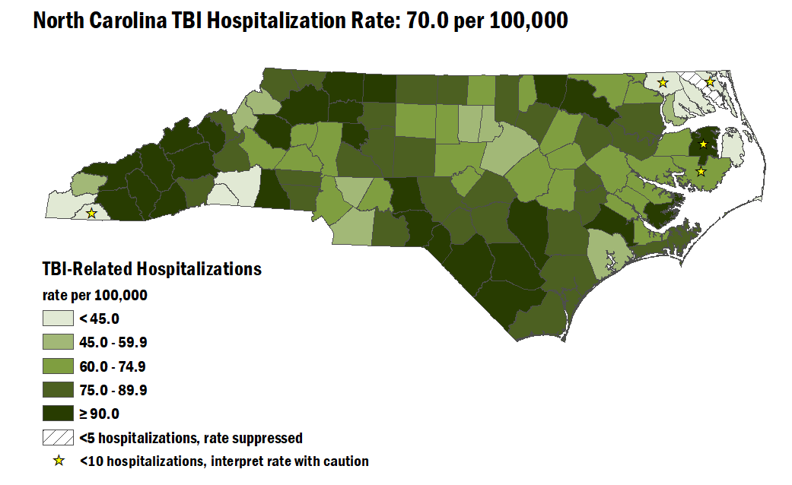
TBI-Related Hospitalizations among North Carolina Residents, 2021-2023
Limited to NC Residents, 2021-2023
Source: NC State Center for Health Statistics, Hospitalization Discharge Data (2021-2023)
Analysis by Injury Epidemiology and Surveillance Unit
Notes:
The overall rate of TBI hospitalizations from 2021-2023 in North Carolina was 70.0 per 100,000. The counties with the highest rates were Swain, Davie, and Stokes counties.

Slide 20
Most TBI-related hospitalizations occurred among men and non-Hispanic Whites
Count by Demographic, 2023
NH – non-Hispanic
Sex was unknown for 2(<0.1%) injury hospitalizations and race/ethnicity was unknown for 194(<0.1%) injury hospitalizations
Limited to NC Residents, 2023
Source: NC State Center for Health Statistics, Hospitalization Discharge Data (2023)
Analysis by Injury Epidemiology and Surveillance Unit
Notes:
In 2023, most TBI hospitalizations occurred amongst male North Carolina residents (n=4,562) and non-Hispanic Whites (n=5,181).

Slide 21
TBI-related hospitalization rates were highest among men and non-Hispanic American Indians / Alaska Natives
Rate by Demographic, 2023
NH – non-Hispanic
Limited to NC Residents, 2023
Source: NC State Center for Health Statistics, Hospitalization Discharge Data (2023)
Analysis by Injury Epidemiology and Surveillance Unit
Notes:
In 2023, the groups with the highest rate of TBI hospitalizations occurred amongst male North Carolina residents (87.8 per 100,000) and non-Hispanic American Indians (79.8 per 100,000).

Slide 22
Unintentional Falls were the leading mechanism-intent category for all TBI hospitalizations
89.5% Unintentional
1.2% Self-Inflicted
5.4% Assault
* Included in other specified are Other Transport - Unintentional (0%), Struck By/Against - Assault (2%),
and Other Land Transport - Unintentional (1%), as well as other mechanism/intents.
Limited to NC Residents, 2023
Source: NC State Center for Health Statistics, Hospitalization Discharge Data (2023)
Analysis by Injury Epidemiology and Surveillance Unit
Notes:
Unintentional fall (53.9%) was the leading mechanism-intent category for TBI hospitalizations. 89.5% of intents were unintentional, followed by assault (5.4%) and self-inflicted (1.2%).

Slide 23
52% of TBI-related hospitalizations occurred among adults 65 and older
Count by Age Group, 2023
Limited to NC Residents, 2023
Source: NC State Center for Health Statistics, Hospitalization Discharge Data (2023)
Analysis by Injury Epidemiology and Surveillance Unit
Notes:
Approximately 52% of TBI-related hospitalizations were among North Carolina adults ages 65 and over.

Slide 24
Adults 85 and older have the highest rates of TBI-related hospitalizations
Rate by Age Group, 2023
Limited to NC Residents, 2023
Source: NC State Center for Health Statistics, Hospitalization Discharge Data (2023)
Analysis by Injury Epidemiology and Surveillance Unit
Notes:
TBI hospitalization rates were highest among those ages 85 and older and began increasing after age 65.

Slide 25

Traumatic Brain Injury Emergency Department Visits

Slide 26
TBI-related ED visits increased by 15% over the last five years
Limited to NC Residents, 2019-2023
Source: NC DETECT (2019-2023)
Analysis by Injury Epidemiology and Surveillance Unit
Notes:
The number of TBI emergency department (ED) visits in North Carolina increased by 22% over the last 5 years (2019-2023).

Slide 27
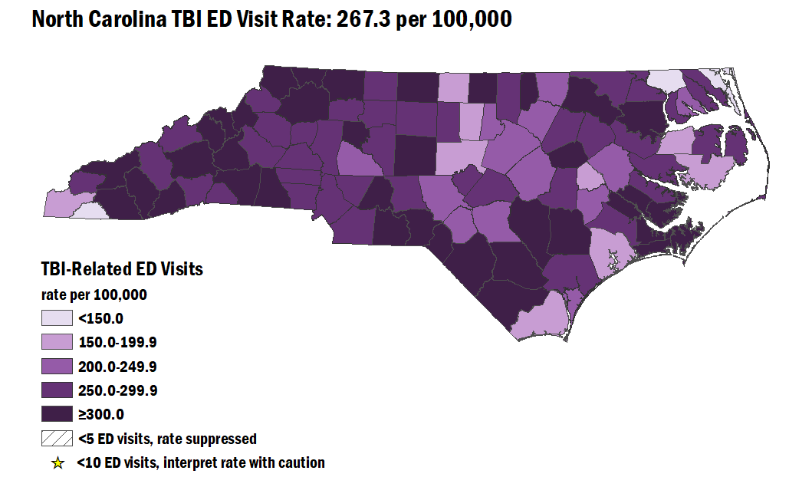
TBI-Related Emergency Department Visits (ED) Among North Carolina Residents, 2021-2023
Limited to NC Residents, 2021-2023
Source: NC DETECT (2021-2023)
Analysis by Injury Epidemiology and Surveillance Unit
Notes:
The overall rate of TBI ED visits from 2021-2023 in North Carolina was 267.3 per 100,000. The counties with the highest rates were Scotland, Transylvania, and Wilkes counties.

Slide 28
Most TBI-related ED visits occurred among men and non-Hispanic Whites
Count by Demographic, 2023
NH - non-Hispanic; sex was unknown for 208(<0.1%) injury ED visits and race/ethnicity was unknown for 829(<0.1%) injury ED visits
Limited to NC Residents, 2023
Source: NC DETECT (2023)
Analysis by Injury Epidemiology and Surveillance Unit
Notes:
In 2023, most TBI ED visits occurred amongst male North Carolina residents (n=16,580) and non-Hispanic Whites (n=19,937).

Slide 29
Rates of TBI-related ED visits were highest among men and non-Hispanic American Indian / Alaska Natives
Rate by Demographic, 2023
Limited to NC Residents, 2023
Source: NC DETECT (2023)
Analysis by Injury Epidemiology and Surveillance Unit
Notes:
In 2023, the groups with the highest rate of TBI ED visits occurred amongst male North Carolina residents (313 per 100,000) and non-Hispanic American Indians (379 per 100,000).

Slide 30
TBI-related ED visits were highest among 25-34- and 75–84-year-olds
Rate by Age Group, 2023
Limited to NC Residents, 2023
Source: NC DETECT (2023)
Analysis by Injury Epidemiology and Surveillance Unit
Notes:
TBI-related ED visits were highest among those ages 25-34 and 75-84 years old.

Slide 31
Adults 85 and older have the highest rates of TBI-related ED Visits
Rate by Age Group, 2023
Limited to NC Residents, 2023
Source: NC DETECT (2023)
Analysis by Injury Epidemiology and Surveillance Unit
Notes:
Adults 85 and older have the highest rate of TBI-related ED visits (1,452 per 100,000).

Slide 32
TBI-related ED visit rates were highest among men ages 85 and older in 2023
Limited to NC Residents, 2023
Source: NC DETECT (2023)
Analysis by Injury Epidemiology and Surveillance Unit
Notes:
By sex, males most often had higher rates of TBI-related ED visits than females. The highest rate was males aged 85 and older (1,610.6 per 100,000).

Slide 33
Summary of Traumatic Brain Injury in North Carolina
In 2023, traumatic brain injuries resulted in:
  Over 2,500 deaths
  Over 7,500 hospitalizations
  Over 30,000 emergency department visits
Most TBI-related injuries and deaths occurred among males and non-Hispanic Whites
Rates of TBI were highest in the 75-84 and 85 and older age groups
Most traumatic brain injuries were related to unintentional falls
Notes:
In 2023, TBI resulted in over 2,500 deaths, 7,500 hospitalizations, and 30,000 ED visits. Most TBI-related injuries and deaths occurred in males and non-Hispanic White individuals. Rates of TBI are highest in older adults. Unintentional falls are a large contributor to TBI-related injuries and deaths in North Carolina.

Slide 34
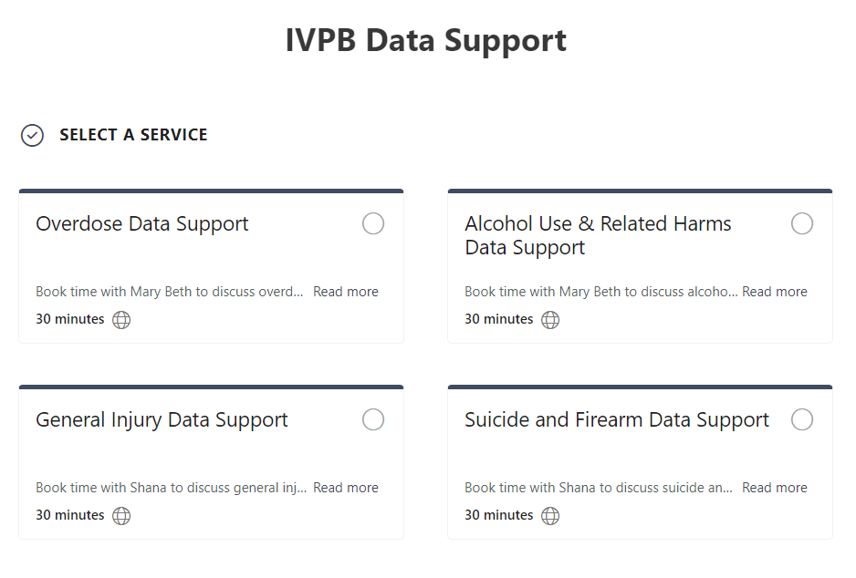

IVPB Data Support now available!
Book time with an IVPB epidemiologist to discuss available data products, to talk through custom data requests, or for general data questions.
IVPB Data Request Policy
IVPB Data Support Bookings

Slide 35
Questions?
InjuryData@dhhs.nc.gov
Injury and Violence Prevention Branch
Division of Public Health
www.dph.ncdhhs.gov/programs/chronic-disease-and-injury/injury-and-violence-prevention-branch

